Slide 1
This service will have the same features as SportsReg. However, this service will have different design, other categories and products/services.

Slide 2




Company (log in)
Register group
Log in
Done
GET NON-BINDING OFFERS – SAVE TIME AND MONEY ON YOUR PURCHASES
Get offers from several suppliers
Done
Choose the best offer based on your needs
It's free and without obligation!
Choose category
Choose product/service
Next
How Russekjøp works

Slide 3











Done
How Russekjøp works
1 Fill out the form 2 Receive offers 3 Choose offer
Save time by simply filling Receive offers from several Choose the best offer out the form. We obtain offers different suppliers and see which based on your needs. from several providers based on offer suits you best. your needs.
Done
Save money on various purchases and collaborations
Musikkanlegg Graffiti og foliering Russebuss Bussjåfør
Dugnad Russeklær Dj og russesang Russelogo

Slide 4





Image with link to «become a supplier» as seen in the footer
Image with link to «News» as seen in the footer.
Done
Done
Telephone post@russekjop.no www.russekjøp.no
Contact
About us News Company register
How it works FAQ
Become a supplier Conditions and terms

Slide 5
Business registration (done from admin page)
Done
Business name
VAT number
Adresse
Telephone
Email 1 (business contact email)
Website
Contact person
Email contact person
This information determines what kind of requests the companies receive from the groups. They only receive requests for the category and products/service they offer, in the right area
When companies offer «Dugnad – Salgsdugnad», ther must also be a additional choice where these companies marks which kind of product they offer (e.g. toiletpaper, greeting cards etc.)
Category
Product/service
Places to sell
Register

Slide 6
Company (log in)
Register group
Log in
Register group
Group name
Contact person
Telephone
Email (username)
Done
Done
Address
Post code
City
Password
Password
I confirm that I am over 18 years old
Register

Slide 7
Company (log in)
Register club
Log in
LOG IN
Email (Username)
Password
Done
Done
Log in
Forgot your password?
Don’t have any account?
Register

Slide 8
Company (log in)
Log out
My offers
[Product/service] – (partners name)
My offers
My profile
[Product/service] – (partners name)

Slide 9
Company (log in)
Log out
[Product/service] – (partners name)
You have got following offer.
My offers
My profile
Quantity: 50 Size: 5 Color: White Other information: Match balls used on artificial grass
Offer in total: 45 000 NOK
Reject offer
Accept offer
Or send a message back to the business
Send
[Product/service] – (partners name)

Slide 10
Company (log in)
Register club
Log in
Log in - business
(this log in information is maked by the admin. Admin will send this information to the business)
Email (Username)
Password
Done
Done
Log in

Slide 11
Company (log in)
Register group
Log in
When they have logged in they will find applications
[Product/service] – [Group name]
When clicking on this, the window will open and partners will find application information the buyer sumbitted.
See next slide
[Product/service] - [Group name]

Slide 12
Company (log in)
Register club
Log in
[Product/service] - [Group name]
(Information from the form the club filled in) Number of footballs: 50 Size of football: 5 Additional information: Training balls for artificial grass
Write your offer…
Send
[Product/service] - [Group name]

Slide 13

Company (log in)
Register club
Log in
Image
Company register
Search
Category 1
Category 2
Category 3
Business 1
Business 2
Business 3
Business 1
Business 2
Business 3
Business 1
Business 2
Business 3
Category 4
Category 5
Category 6
Business 1
Business 2
Business 3
Business 1
Business 2
Business 3
Business 1
Business 2
Business 3

Slide 14

Company (log in)
Register club
Log in
Image
Company register
Search
When clicking on the business name, more information about the business will show.
Training equipment
Stadium equipment
Football travel and tickets
Business 1
Business 2
Business 3
Business 1
Business 2
Business 3
Business 1
Business 2
Business 3
Website: www.business.no Telephone: 000 000 000 Email: business@business.no Adresse: Business road 1, 1231 Business
Logo
Transportation
Graphic design
Business 1
Business 2
Business 3
Business 1
Business 2
Business 3

Slide 15
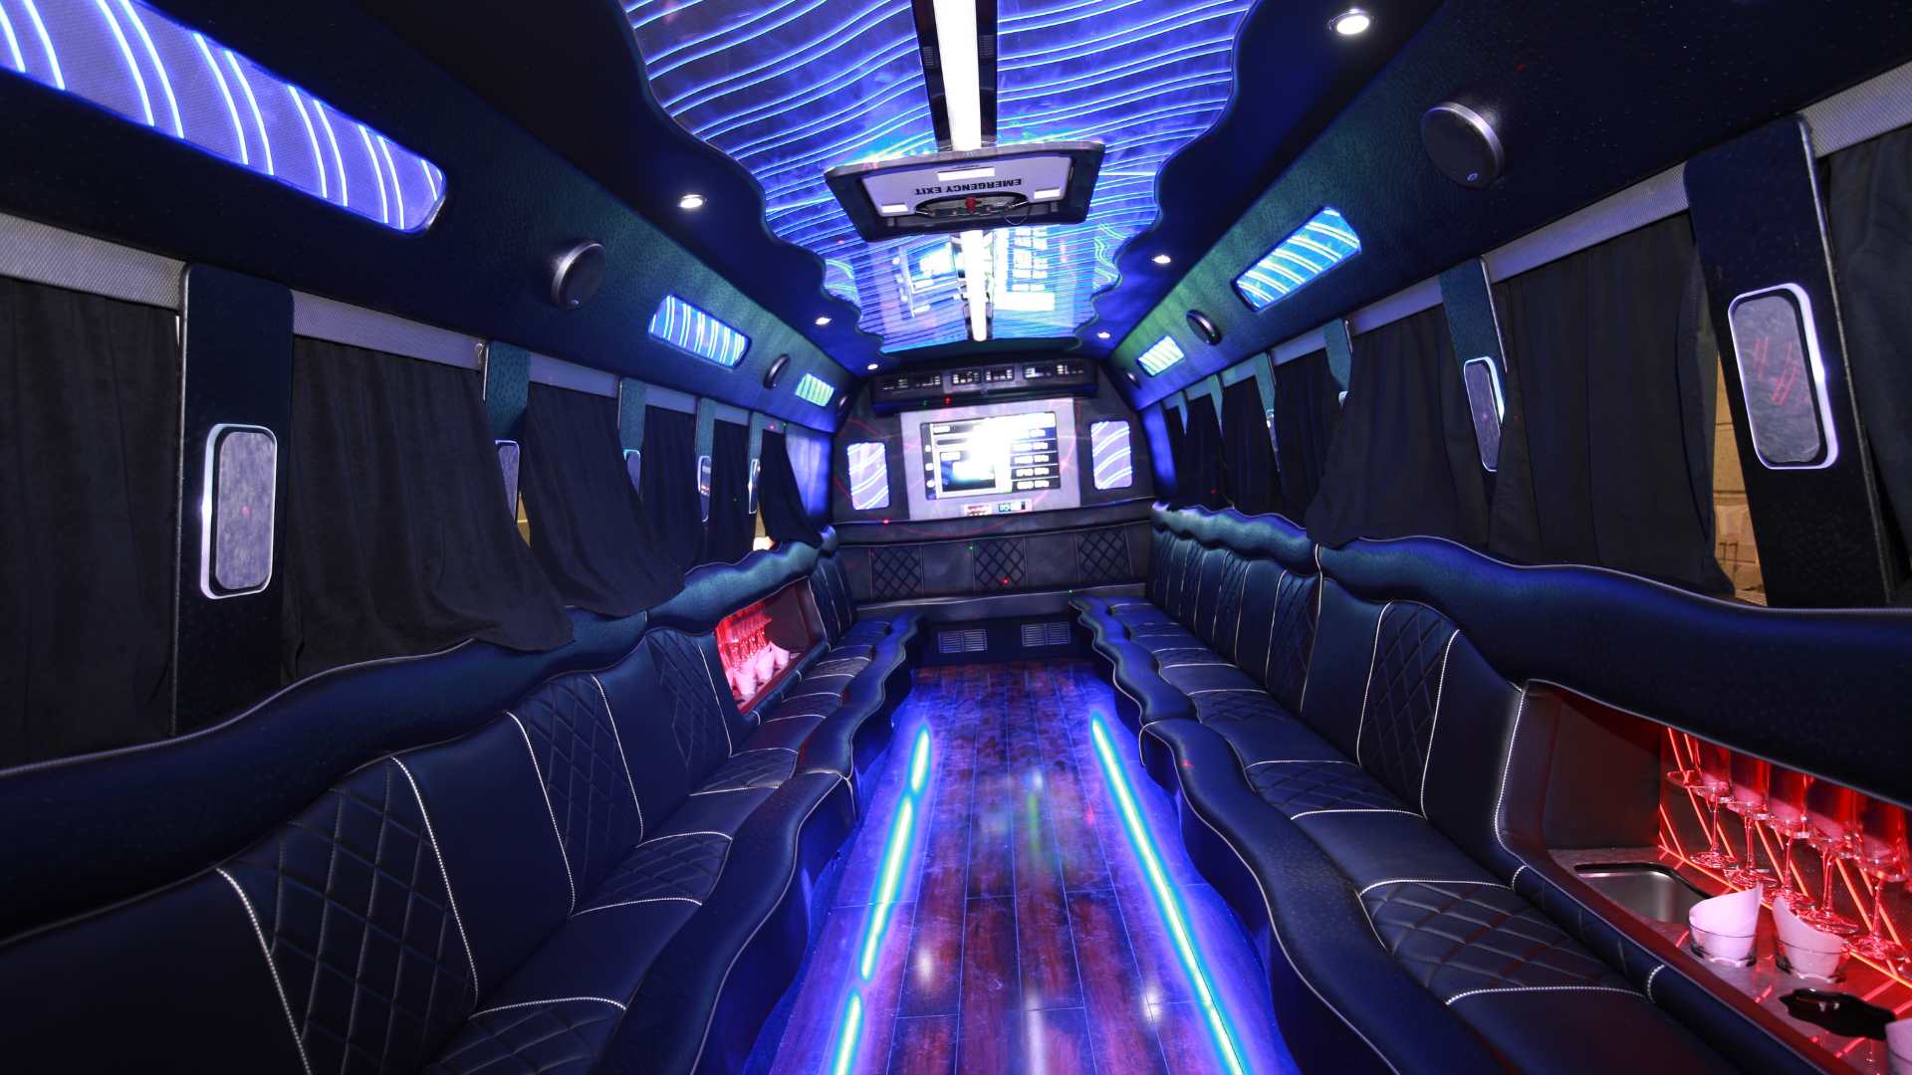
Company (log in)
Register club
Log in
About us
Dssdf sdfmsdfm mfsdfllksdnf
Sdfmksdfnskdl
Sdfmksadfmksdlmf
Sdmfksdmfk
Sdf
Sdfsdkmdfff sdfmssdfsdf
Sdfsdfdsf
Done
Dskfmsldkfmsdklfmslkdmfsd fsdmfksdf sdkf sadkf sdf sfsdmf ksmfksdf
S dkfmsadklfmsd fsdkf sdfkmsadkf dsafmsdlf sadl fklsdafsd fsdfdsfsdlfmsdaløfmsd v
Sdmfsdlfksadlkfmsdklfmsdkl skladmfklsd f skdmfsd f skldfmlsd fsld fsdf slf asd fds fdsf

Slide 16
Company (log in)
Register club
Log in
Blog/news
News 1, Admin should decide which news to be shown as main news.
News 2
News 3
News 4

Slide 17
Company (log in)
Register club
Log in
Contact us
Name
Email
Done
Telephone (optional)
Your message
Send

Slide 18
Company (log in)
Register club
Log in
FAQ
Same FAQ solution as you made for Fotballkviss.
Done

Slide 19
Company (log in)
Register club
Log in
How it works
I will make an image/drawing as in fotballkviss.
Done

Slide 20

Company (log in)
Register club
Log in
Become a supplier
Er din bedrift på utkikk etter flere kunder, eller har som mål å øke salget og inntjeningen? Russekjøp er derfor den foretrukne plattformen. Ved å registrere seg som leverandør vil din bedrift få direkte tilgang til planlagte kjøp fra russegrupper. Dette gir dere muligheten til å kjempe om nye kunder og nye salg. Ved siden av ovennevnte vil din bedrift også bli registret i vårt leverandørregister og vi tilbyr tilgang til kjøp av innholdsmarkedsføring i våre kanaler. Dersom dette høres interessant ut – kontakt oss i skjemaet nedenfor. Dere vil så bli kontaktet av oss i løpet av kort tid.
Done
Done

Slide 21
Company (log in)
Register club
Log in
Conditions and terms
I will make text for this page.
Done

Slide 22
Categories and products/service
Klær og sko 23 Russedress Sko Gensere/hettejakker Jakker T-skjorte Singlet
Hodeplagg og accessories 25 Ørepropper Caps / Bøttehatt Russelue Hårbånd
Trykkeri 26 Strykemerker Trykk av klær og utstyr
Russekort 27 Russekort
Musikk og DJ 28 DJ Video Russesang Dugnad 29 Salgsdugnad
Profileringsartikler 30 Profileringsartikler
Russebuss/bil 31 Garasje/Oppbevaring Bussbygging Bussjåfør Graffiti Foliering Grafisk 32 Russelogo Design Banner Buss-/bilfoliering Graffiti
Markedsføring 33 Banners Klistremerker og stickers
Lyd & lys 34 Aggregat Lys Musikkanlegg Høyttalere og Forsterkere
There will be different forms for the different products/services. Some products will have same form.

Slide 23
Clothes and shoes – Russedress
Number of russedress
Color
Size (e.g; Small = 3, Medium = 4, Large =3)
Print
Yes No
Number of diploms
Please provide us with additional information about your needs.
Send
This form should be used on following products in the categori «clothes and shoes»: Russedress, Sweater, Jacket, t-shirt, singlet.

Slide 24
Clothes and shoes - Shoes
Number of shoes
Color
Size (e.g; Small = 3, Medium = 4, Large =3)
Number of diploms
Please provide us with additional information about your needs.
Send

Slide 25
Dugnad – Salgsdugnad
Number of people
Number of products per person
Number of sales round
Current products you want offers on
Toiletpaper Paper towels Socks
Lighter briquettes Cleaning products Sm Cookies and goodies
They can mark several of these
Greeting card/Christmas card Cured meat and meat products Other
Number of diploms
Please provide us with additional information about your needs.
Send

Slide 26
Hodeplagg og accessories - Russelue
Number of russelue
Color
Size (e.g; Small = 3, Medium = 4, Large =3)
Number of diploms
Please provide us with additional information about your needs.
Send

Slide 27
Hodeplagg og accessories - Caps
Number of caps
Color
Size (e.g; Small = 3, Medium = 4, Large =3)
Print
Yes No
Number of diploms
Please provide us with additional information about your needs.
Send

Slide 28
Hodeplagg og accessories - Hårbånd
Number of hårbånd
Color
Size (e.g; Small = 3, Medium = 4, Large =3)
Print
Yes No
Number of diploms
Please provide us with additional information about your needs.
Send

Slide 29
Hodeplagg og accessories - Ørepropper
Number of ørepropper
Color
Size (e.g; Small = 3, Medium = 4, Large =3)
Number of diploms
Please provide us with additional information about your needs.
Send

Slide 30
Russekort – Russekort
Number of russekort totalt
Number of different russekort
Color
Number of diploms
Please provide us with additional information about your needs.
Send

Slide 31
Markedsføring – Klistremerker og stickers
Number of klistremerker and stickers
Color
Size
Number of diploms
Please provide us with additional information about your needs.
Send

Slide 32
Markedsføring – Banner
Number of banners
Size
Number of diploms
Please provide us with additional information about your needs.
Send

Slide 33
Musikk og video –
Number of diploms
Please provide us with additional information about your needs.
Send
This form should be used on following products in the categori «Musikk og video»: DJ, video and russesang.

Slide 34
Grafisk design –
Number of diploms
Please provide us with additional information about your needs.
Send
This form should be used on following products in the categori «Grafisk design»: Buss-/bilfoliering, graffiti, logo, design.

Slide 35
Lyd og lys – Aggregat
Number of diploms
Please provide us with additional information about your needs.
Send
This form should be used on following products in the categori «Lyd og lys»: Aggregat, Lys, musikkanlegg, høyttalere og forsterkere

Slide 36
Lyd og lys – Aggregat
Number of diploms
Please provide us with additional information about your needs.
Send
This form should be used on following products in the categori «Russebuss/bil»: Garasje/oppbevaring, bussbygging, graffiti, foliering.

Slide 37
Trykkeri – Strykemerker
Number of diploms
Please provide us with additional information about your needs.
Send
This form should be used on following products in the categori «Trykkeri»: Strykemerker, trykk på klær og utstyr

Slide 38
Russebuss/bil - Bussjåfør
From date
To date
Price for assignment:
Number of diploms
Please provide us with additional information about your needs.
Send

